Slide 1
Chapter 2.4 Creating High-Quality Code
CCSW 325 (Software Construction)
Notes:
Last Update: 22/8/2019
Version 1.0

Slide 2
Outline
Working Classes (Part 1 of 3)
Class Foundations: Abstract Data Types (ADTs)
Good Class Interfaces

Slide 3
Working Classes
In the dawn of computing, programmers thought about programming in terms of statements. Throughout the 1970s and 1980s, programmers began thinking about programs in terms of routines. In the twenty-first century, programmers think about programming in terms of classes.

Slide 4

Working Classes
A class is a collection of data and routines that share a cohesive, well-defined responsibility. A class might also be a collection of routines that provides a cohesive set of services even if no common data is involved
Maximizes the portion of a program that you can safely ignore while working on another section of code

Slide 5
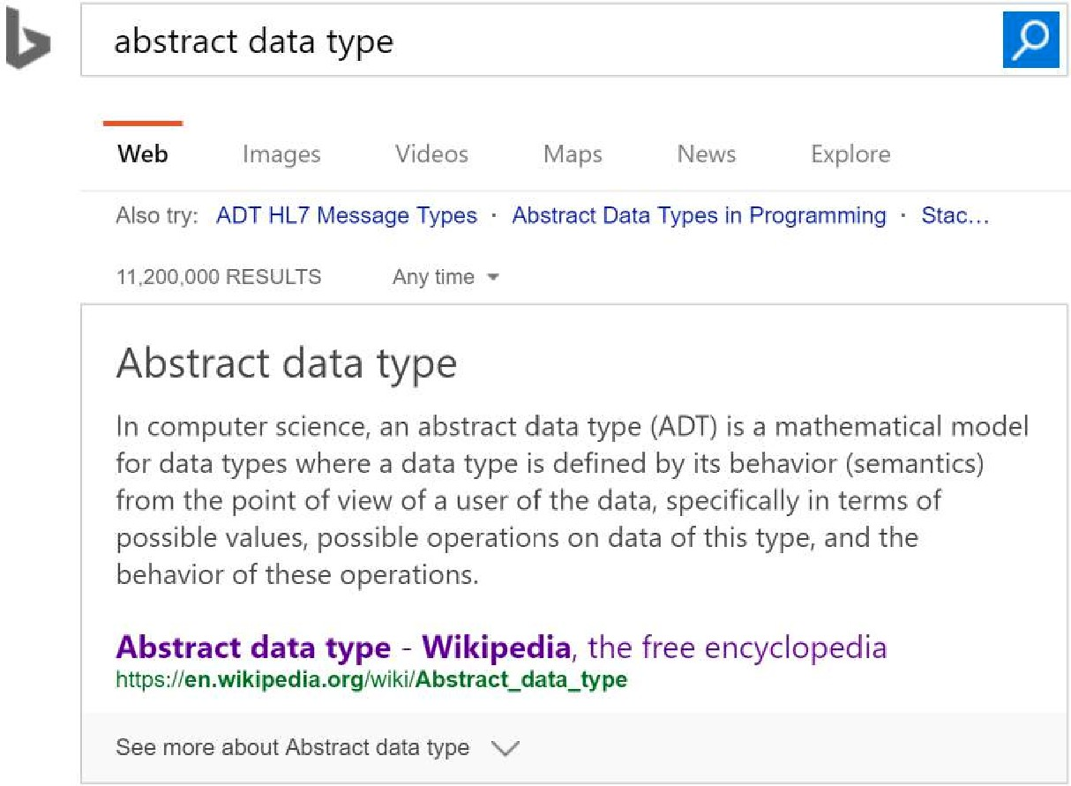
Class Foundations: Abstract Data Types (ADTs)
An abstract data type is a collection of data and operations that work on that data.
Understanding ADTs is essential to understanding object-oriented programming.
An ADT might be a graphics window with all the operations that affect it, a file and file operations, an insurance-rates table and the operations on it, or something else

Slide 6
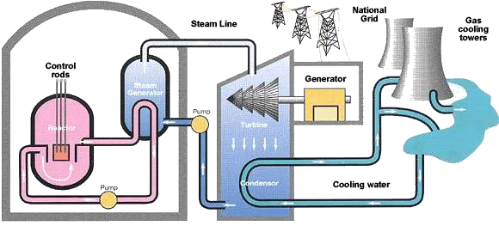
Class Foundations: Abstract Data Types (ADTs)
Suppose you’re writing software that controls the cooling system for a nuclear reactor. You can treat the cooling system as an abstract data type.
coolingSystem.GetTemperature() coolingSystem.SetCirculationRate( rate ) coolingSystem.OpenValve( valveNumber ) coolingSystem.CloseValve( valveNumber )
The specific environment would determine the code written to implement each of these operations.
The rest of the program could deal with the cooling system through these functions and wouldn’t have to worry about internal details of data-structure implementations, data- structure limitations, changes, and so on.

Slide 7

Class Foundations: Abstract Data Types (ADTs)
You can hide implementation details
Changes don’t affect the whole program
You can make the interface more informative
It’s easier to improve performance
The program is more obviously correct
The program becomes more self-documenting
You don’t have to pass data all over your program
You’re able to work with real-world entities rather than with low-level implementation structures

Slide 8
Good Class Interfaces
The first and probably most important step in creating a high-quality class is creating a good interface.
Creating a good abstraction for the interface to represent and ensuring that the details remain hidden behind the abstraction.
Good Abstraction
Good Encapsulation

Slide 9

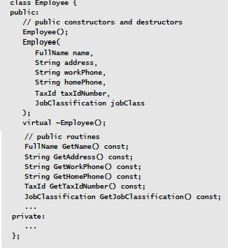
Good Class Interfaces: Good Abstraction
A class interface provides an abstraction of the implementation that's hidden behind the interface
It would contain data describing the employee's name, address, phone number, and so on. It would offer services to initialize and use an employee
Internally, this class might have additional routines and data to support these services, but users of the class don't need to know anything about them, so it is great.

Slide 10
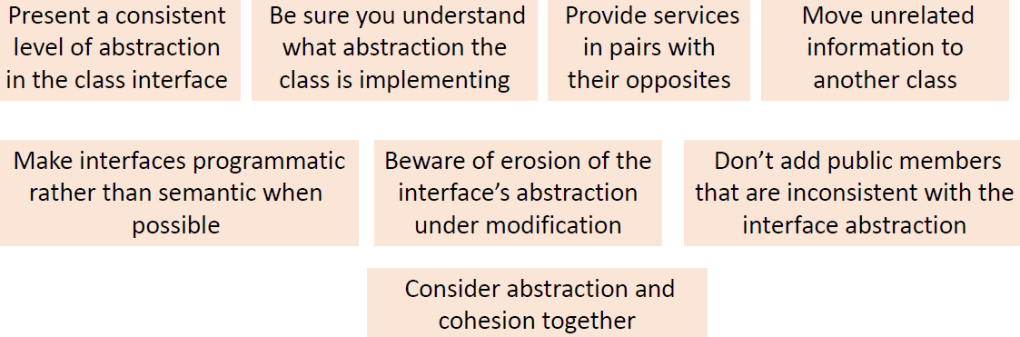
Good Class Interfaces: Good Abstraction
The pursuit of good abstract interfaces gives rise to several guidelines for creating class interfaces.

Slide 11
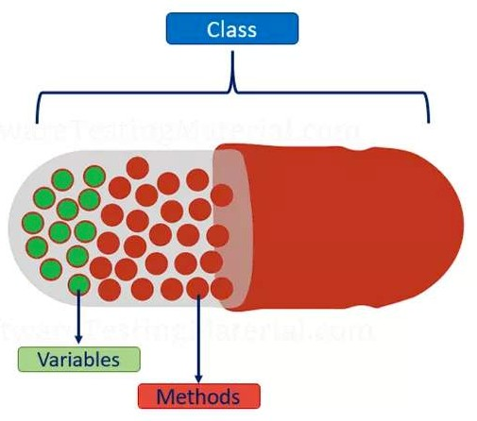
Good Class Interfaces: Good Encapsulation
Abstraction helps to manage complexity by providing models that allow you to ignore implementation details. Encapsulation is the enforcer that prevents you from looking at the details even if you want to
Without encapsulation, abstraction tends to break down

Slide 12
Good Class Interfaces: Good Encapsulation
Minimize accessibility of classes and members
If exposing the routine is consistent with the abstraction, it's probably fine to expose it. If you're not sure, hiding more is generally better than hiding less.

Slide 13
Good Class Interfaces: Good Encapsulation
Don’t expose member data in public
Exposing member data is a violation of encapsulation and limits your control over the abstraction
float GetX();
float GetY();
float GetZ();
void SetX( float x );
void SetY( float y );
void SetZ( float z );
float x; float y; float z;

Slide 14
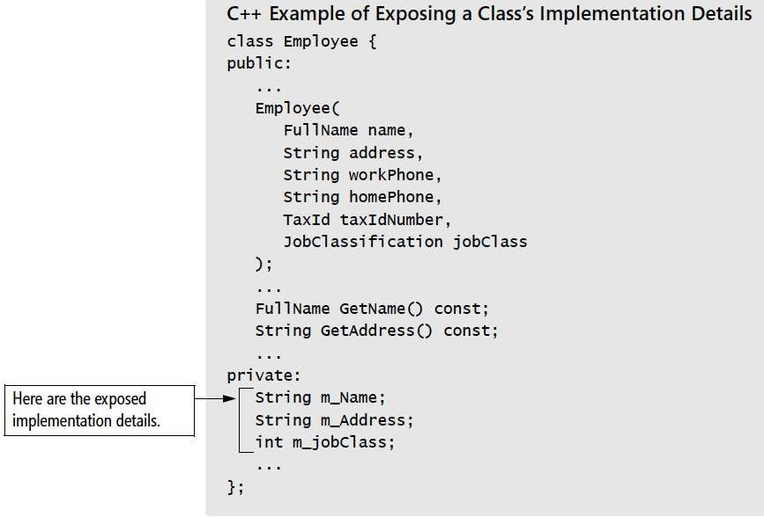
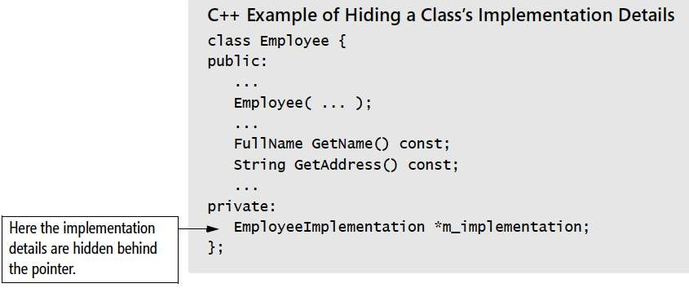
Good Class Interfaces: Good Encapsulation
Avoid putting private implementation details into a class’s interface
With true encapsulation, programmers would not be able to see implementation details at all

Slide 15
Good Class Interfaces: Good Encapsulation
Don’t make assumptions about the class’s users
A class should be designed and implemented to adhere to the contract implied by the class interface.
It shouldn’t make any assumptions about how that interface will or won’t be used,
// initialize x, y, and z to 1.0 because DerivedClass blows
// up if they're initialized to 0.0

Slide 16
Good Class Interfaces: Good Encapsulation
Be very, very wary of semantic violations of encapsulation
The difficulty of semantic encapsulation compared to syntactic encapsulation is similar.
Not calling Class A’s InitializeOperations() routine because you know that Class A’s PerformFirstOperation() routine calls it automatically.
Not calling the database.Connect() routine before you call employee.Retrieve( database ) because you know that the employee.Retrieve() function will connect to the database if there isn’t already a connection.
Not calling Class A’s Terminate() routine because you know that Class A’s PerformFinalOperation() routine has already called it.
Using a pointer or reference to ObjectB created by ObjectA even after ObjectA has gone out of scope, because you know that ObjectA keeps ObjectB in static storage and ObjectB will still be valid.
Using Class B’s MAXIMUM_ELEMENTS constant instead of using ClassA.MAXIMUM_ELEMENTS , because you know that they’re both equal to the same value.

Slide 17
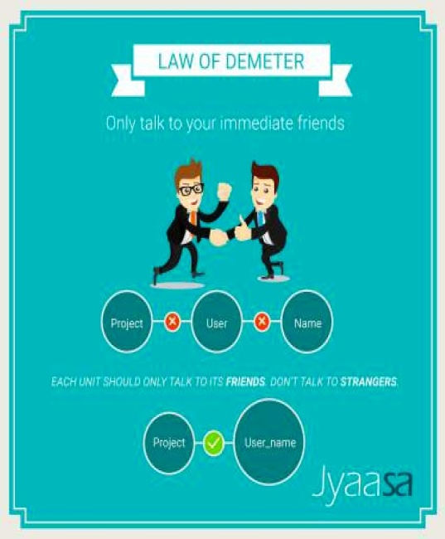
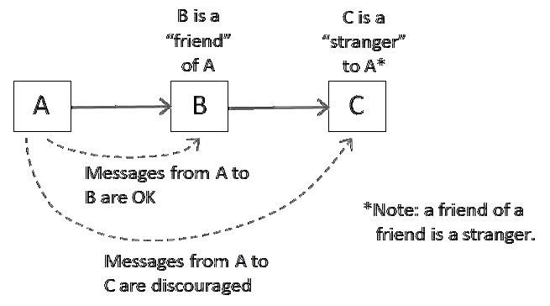
Good Class Interfaces: Good Encapsulation
Watch for coupling that’s too tight
In general, the looser the connection, the better
Minimize accessibility of classes and members.
Make data private rather than protected in a base class to make derived classes less tightly coupled to the base class.
Avoid exposing member data in a class’s public interface
Be wary of semantic violations of encapsulation
Observe the “Law of Demeter”

Slide 18
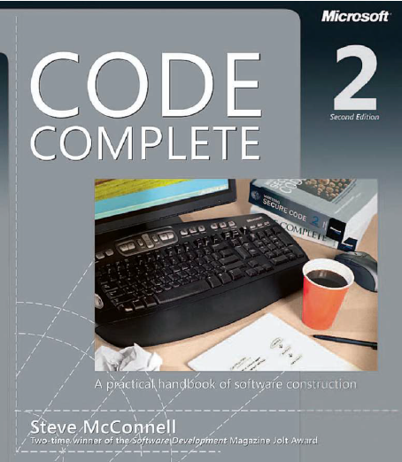
Reading
Code Complete: A Practical Handbook of Software Construction, 2nd Edition, Steve McConnell.
Chapter 6

Slide 19

Any questions? ​
Please feel free to raise your hands and ask.

